Slide 1

Blood Bank
Management
System

Slide 2
GROUP NO :. 11
KANIKA AGRAWAL 201812045
MAHIMA GAJIWALA 201812062
PRACHI JAIN 201812070
DHWANI KSHTRIYA 201812077
YASH MEHTA 201812085
DEVARSHI SHAH 201812094
SONIYA VAIDYA 201812113
DENISH MANIYA 201812118
YOGESH THAKKAR 201812121

Slide 3
CONTENT
Project Definition
SRS
Purpose
Scope
Identification of needs
Technology used
Functional Requirements
Non-Functional Requirements
Modules
User Characteristics
Use Case Diagram
Activity Diagram
Data Dictionary

Slide 4
PROJECT DEFINITION
This is a web-based application system that is to be used by the blood banks and hospitals as a means to allow the public to make online request for the blood.
The system keeps the record of all the Donors, Recipients, Blood Donation Camps, Hospitals and blood banks.
This system also has the ability to keep track of the donor's donation records and the blood stock in the blood bank. This project intends to computerize the blood and donor details in a system in order to improve the record management efficiency due to the grown size of records of data.

Slide 5
SCOPE
This system will help to improve the reliability of data maintenance and provide a fast and efficient way to find blood from hospital, blood bank or donor.
The main objective of blood bank management system is ....
Manage details properly
Maintaining the details of all stakeholders
Maintain Blood stock

Slide 6
NON-FUNCTIONAL REQUIREMENTS
Performance Requirements
The system need to be reliable.
If the process doesn’t complete properly, appropriate error message will display.
Safety Requirements
After entering user id and password the user can access his/her profile.
The details need to be maintained properly.
Users must be authenticated.

Slide 7
TECHNOLOGY USED
Tools & Technology
Front-end: HTML5, CSS, Bootstrap, JavaScript, JQuery
Back-end: PHP 7.0
Server: SMTP, XAMPP server
Database: MySQL

Slide 8
FUNCTIONAL REQUIREMENTS
User Login
Donor Registration
Hospital Registration
Blood bank Registration
Camp organizer Registration
Organization of camp
Blood request
Notify detail of expired stock
Camp notification
Blood request notification
Upload blood collection details

Slide 9
MODULES
Blood bank details
Donor details
Hospital details
Recipient details
Blood stock details
Camp details

Slide 10
USE CASE DIAGRAM

Slide 11
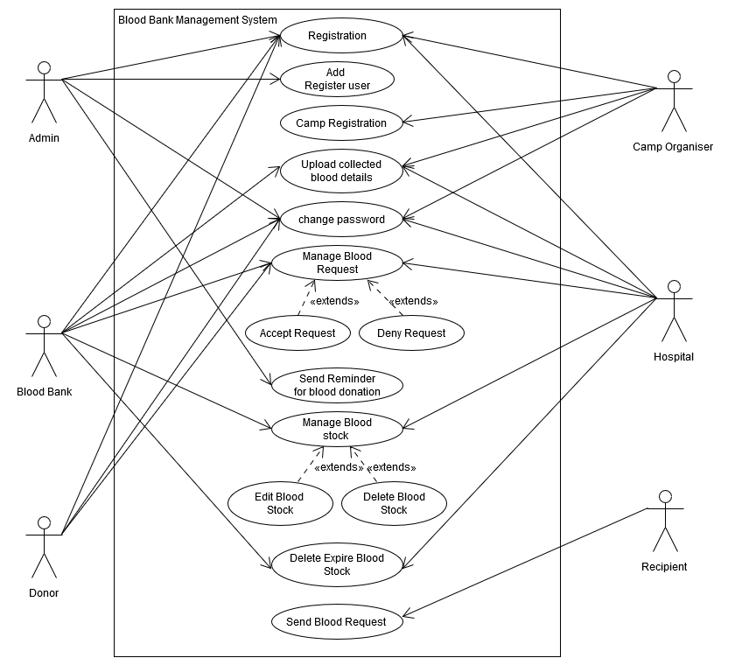

Slide 12
ACTIVITY DIAGRAM UML Document

Slide 13
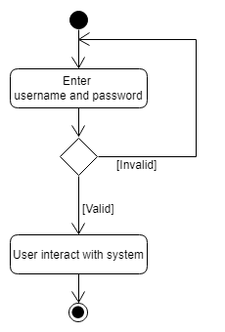
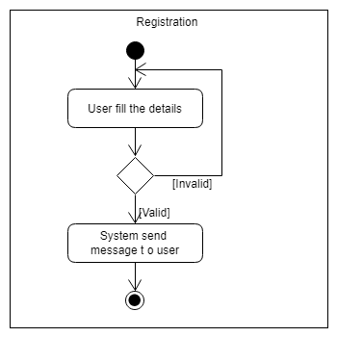
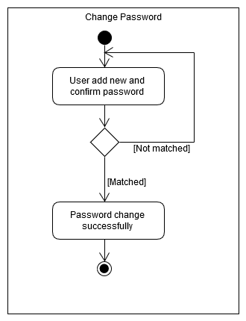
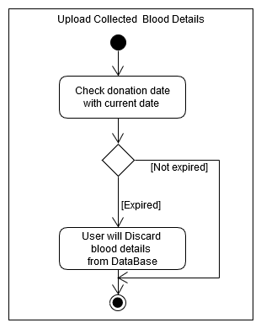
Login

Slide 14
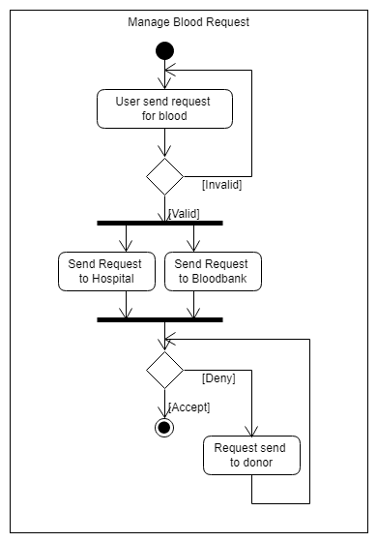
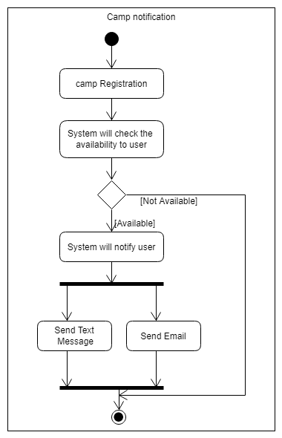

Slide 15
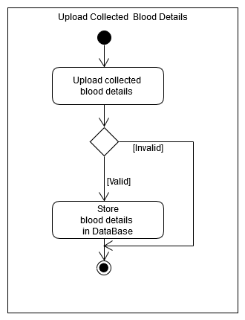
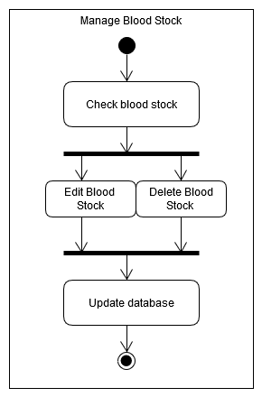
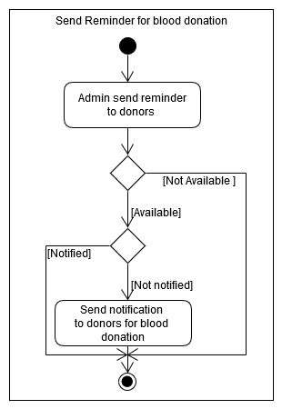

Slide 16
DATA DICTIONARY

Slide 17
tbl_admin
Name | Datatype | Constraint | Description
admin_email | varchar(50) | Primary Key | Unique identifier of admin
admin_name | varchar(50) | Not Null | Name of admin
admin_contact | varchar(13) | Not Null | Phone or contact number of admin
admin_password | varchar(50) | Not null | Auto generated password for admin

Slide 18
tbl_organization
Name | Datatype | Constraint | Description
org_email | varchar(50) | Primary Key | Unique identifier of organization table
org_name | varchar(50) | Not Null | Name of organization
org_contact | varchar(13) | Not Null | Contact number of organizations
org_password | varchar(50) | Not Null | Auto generated password of organization
org_address | varchar(100) | Not Null | Address of organization

Slide 19
tbl_ blood
Name | Datatype | Constraint | Description
blood_id | bigint | Primary Key | Unique identifier of blood stock
blood_donor_name | varchar(50) | Not Null | Name of blood donor
blood_group | varchar(3) | Not Null | Blood group of donor
blood_donor_gender | varchar(6) | Not Null | Gender of blood donor
blood_givenDate | date | Not null | Donation date
blood_donor_email | varchar(50) | Not Null | Email Id of blood donor
blood_donor_contact | varchar(13) | Not Null | Phone or contact number of blood donor

Slide 20
tbl_ donor
Name | Datatype | Constraint | Description
donor_email | varchar(50) | Primary Key | Unique identifier of donor
donor_name | varchar(50) | Not Null | Name of blood donor
donor_gender | char(1) | Not Null | Gender of blood donor
donor_dob | date | Not null | Birthdate of blood donor
donor_city | varchar(20) | Not null | City where blood donor lives
donor_area | varchar(20) | Not null | Region where blood donor’s house is located
donor_address | varchar(100) | Not null | Specific location of blood donor’s residence
donor_contact | varchar(13) | Not Null | Phone or contact number of blood donor
donor_blood_group | varchar(3) | Not Null | Blood group of donors
donation_date | date | Not Null | Date of previous blood donation
donor_service | char(1) | Not null | Approach of notifying the donor Eg. Via SMS or Email
donor_donation_months | int | Not Null | Months duration of donating blood which donor prefers
donor_password | varchar(12) | Not null | Auto generated password for blood donor

Slide 21
tbl_ recipient
Name | Datatype | Constraint | Description
recipient_id | bigint | Primary Key | Unique identifier of recipient
recipient_name | varchar(50) | Not Null | Name of requester
Patient_name | Varchar(20) | Not Null | Name of patient
patient_gender | char(1) | Not Null | Gender of patient
patient_blood_group | char(3) | Not Null | Blood group of patient
recipient_contact | varchar(13) | Not Null | Phone or contact number of recipient
recipient_area | varchar(20) | Not null | Region where recipient’s house is located
recipient_address | varchar(100) | Not null | Address of recipient
recipient_relation | varchar(30) | Not Null | Relation of recipient with patient
hospital_name | varchar(50) | Not Null | Name of the hospital
doctor_name | varchar(50) | Not null | Name of the doctor
recipient_status | char(1) | Not null | Status of blood request is accepted or not If yes then 1 else 0

Slide 22
tbl_ camp
Name | Datatype | Constraint | Description
camp_id | bigint | Primary Key | Unique identifier of blood donation camp
camp_name | varchar(50) | Not Null | Name of blood donation camp
camp_org_email | varchar(50) | Not Null | Email Id of blood donation camp organizer
camp_venueDate | date | Not Null | Date when blood donation camp will be organized
camp_registrationDate | date | Not null | Date when blood donation camp has registered
camp_location | varchar(100) | Not null | Place or venue where the blood donation camp will be held
camp_time | time | Not null | Time from when the blood donation camp will be started
camp_contact | varchar(13) | Not Null | contact number of camp

Slide 23
tbl_ hospital
Name | Datatype | Constraint | Description
hospital_email | varchar(50) | Primary Key | Unique identifier of hospital
hospital_name | varchar(50) | Not Null | Name of hospital
hospital_area | varchar(20) | Not Null | Region where hospital is located
hospital_contact | varchar(13) | Not Null | Phone or contact number of hospitals
hospital_address | varchar(100) | Not null | Specific location of hospital
hospital_password | varchar(12) | Not null | Auto generated password for hospital

Slide 24
tbl_ blood_bank
Name | Datatype | Constraint | Description
bloodbank_email | varchar(50) | Primary Key | Unique identifier of blood bank
bloodbank_name | varchar(50) | Not Null | Name of blood bank
bloodbank_area | varchar(20) | Not null | Region where blood bank is located Eg. Sector 22
bloodbank_contact | varchar(13) | Not Null | Phone number of blood bank
bloodbank_address | varchar(100) | Not Null | Specific location of blood bank
bloodbank_password | varchar(12) | Not Null | Auto generated password of blood bank

Slide 25
USER MANUAL
https://drive.google.com/open?id=1N2o5Bn57Zc9p8vswuBg-UCx2QzQbLGPA

Slide 26
Future Enhancement and conclusion: -
This web application avoids the manual work and the problems concerned with it. It is an easy way to obtain the information that is present in our System. Well, we have worked hard in order to present an improved web application better than the existing one’s regarding the information about the various activities. Still, we found out that the project can be done in a better way in future for that we think that donor details can fetch via Aadhaar card.

Slide 27
Learning during the Project: -
we learned more functionalities about this project
Also, we learned more about PHP language

Slide 28
THANK YOU

